Slide 1

Machine Learning using Python
Ashvani dubey

Slide 2
Agenda
Learning from data
Supervised/unsupervised learning
Regression vs classification
Linear models (linear regression, logistic regression, naive Bayes & SVM)
Non-linear models (KNN, Decision Trees & Random Forest)
Bias variance trade-off (overfitting & underfitting)
Resampling techniques
Model selection & hyperparameter tunning
Weight lifting exercise dataset – practice problem

Slide 3
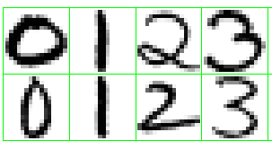
Learning from Data
Outcome measure (qualitative or quantitative) that we want predict based on a set of features
Whether a patient, hospitalized due to heart attack will have a second heart attack
Identify the numbers in a handwritten ZIP code, from a digitized image
Estimate the amount of glucose in the blood of a diabetic person
Price of a house
Training data is used where we observe the outcome and feature measurements
Build a prediction model ( a learner) based on training data to be used on unseen data
Above is example of supervised learning problem
Unsupervised learning problem – observe only feature measurements

Slide 4
Learning from Data
Outcome/target can be either qualitative or quantitative
Qualitative outcomes also referred as discrete/categorical or factor variables
Handwritten digit example the output is one of 10 different digit classes
In the Iris discrimination example, the output is in a finite set {Virginica, Setosa and Versicolor}.
No explicit ordering in the classes
Quantitative outcome where some measurements are bigger than the other, numeric outcome.
House price
Amount of glucose in the blood
Type of outcome decides type of prediction task.
Regression – Quantitative, Classification – Qualitative

Slide 5
Learning from Data
A categorical variables can be of 2 types
Nominal (unordered)
Ordinal (ordered)
There is an ordering between values but no metric notion
Software bug rating (critical, medium, low)
Survey response (very satisfied to very dissatisfied)
The difference between small and medium need not be the same as medium and large
Qualitative variables are typically represented numerically by codes
Success (1) or failure (0 or -1)
Survived (1) or died (0 or -1)

Slide 6
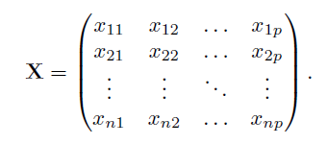
Learning Task
X
Y
Inputs (X) are length and width of each sepal and petal (4 features/inputs)
Outcome (y) is flower variety
In X, each row represents an observation or record
In X, each column represents specific value of the feature
X can be n by p matrix and y is n by 1 matrix (vector).
Given the value of an input vector (X), make a good prediction of the outcome (y)
Use the training data i.e. a set of measurements (x_i, y_i), i = 1, 2, ….n to construct the prediction

Slide 7

Learning Task
Assuming there is some relationship between X and y
ϵ is a random error term, which is independent of X and has a zero mean
Objective is to estimate f
Two benefits of estimating f
Prediction
Inference

Slide 8
Inference using f
Which predictors are associated with the response
What is the relationship between the response and each predictor
Can the relationship between Y and each predictor be adequately summarized using a linear equation, or is the relationship more complicated

Slide 9

Estimating f
Find a function f_hat such that Y ≈ f_hat(X) for any observation (X, Y ).
Parametric method
Makes an assumption about function form (shape) of f
income ≈ β0 + β1 × education + β2 × seniority
Use the training data to fit or train the model
Non-parametric methods do not make explicit assumptions about the functional form of f
Seek an estimate of f that gets as close to the data points as possible without being too rough or wiggly

Slide 10

Assessing Model Performance
In regression setting, MSE (mean square error) is the most common
The MSE will be small if the predicted responses are very close to the true response.
The MSE on training data is training MSE but we want lower MSE on unseen data
We want the method that gives the lowest test MSE, as opposed to the lowest training MSE
There is no guarantee that the method with the lowest training MSE will also have the lowest test MSE

Slide 11
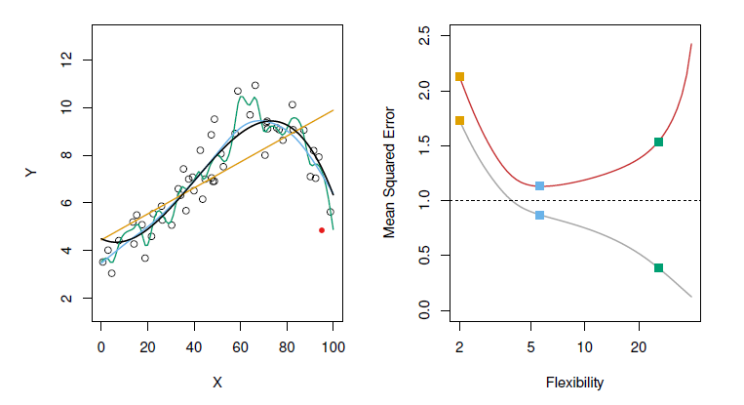
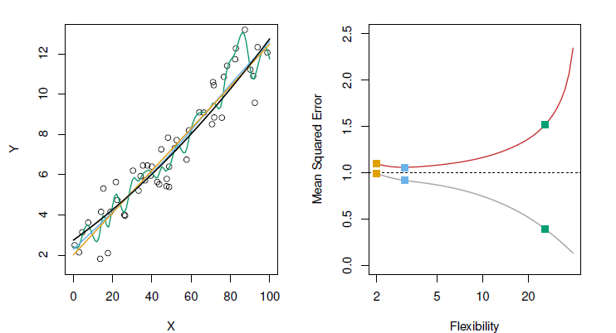
Bias Variance Trade Off
Data is simulated from f, in black. 3 estimates of f (in orange, green and blue color)
Right chart, training MSE (grey) & Test MSE (orange)
The level of flexibility increases train MSE decreases

Slide 12

Bias Variance Trade Off
Expected MSE at any point x0 can be written as
Select a method that simultaneously achieves low bias and low variance
Variance refers to the amount by which f_hat would change if we estimated it using a different training data set
In general, more flexible statistical methods have higher variance
Bias refers to the error that is introduced by approximating a real-life problem, which may be extremely complicated, by a much simpler model.
More flexible statistical methods have smaller bias

Slide 13
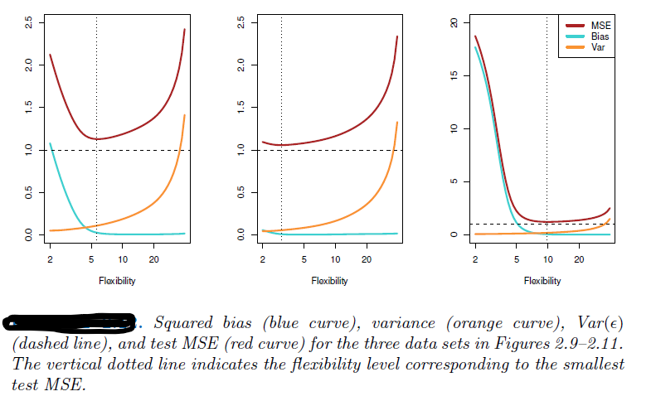
Bias Variance Trade Off

Slide 14

Model Performance - Classification
Training error rate is the proportion of mistakes that are made
The above formula computes fraction of misclassification
Error rate on test data is important similar to regression setting
A good classifier is one for which the test error is smallest
Bias variance trade-off transfers to classification setting as well with some modification

Slide 15
Knowledge Check
What is a model?
What is supervised learning/unsupervised learning?
Difference between classification and regression?
What is generalization error? Why it is important?
Why do we need to estimate f (pattern between X and y)?
What is Bias Variance Trade-off?
Variance of flexible model? Bias? Accuracy computation?

Slide 16
Q&A
Codes

Slide 17
Q&A

